Slide 1

Bruised Britain –
The Case for Income Protection
Exploring the Physical and Financial Impact of Everyday Accidents
A research study by National Friendly
For Adviser use only

Slide 2
Today’s agenda
Why everyday accidents matter
Key findings – the reality of accidents
Common outcomes of accidents
Long term consequences
The hidden costs of accidents
Why protection matters
Our product family
About Us

Slide 3

Why everyday accidents matter
Everyday accidents are more common than many people realise, with significant consequences for health, finances, and daily life.
We commissioned independent research to enhance our protection cover, to ensure our income protection plans suit consumer needs and provide real value for everyday people.
The research was conducted by Opinium Research between 1-5 November 2024 among 2,000 UK adults.
Our research sheds light on the impacts of accidents and emphasises the importance of financial protection. It can help to overcome objections your client may have.

Slide 4
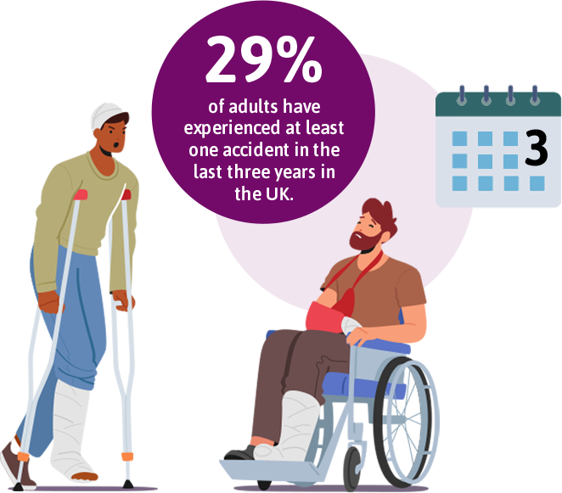
Why everyday accidents matter
Key findings: The Reality of everyday accidents
29% of adults have experienced at least one accident in the last three years.
Younger adults (under 35) are particularly affected, with 37% experiencing accidents.

Slide 5
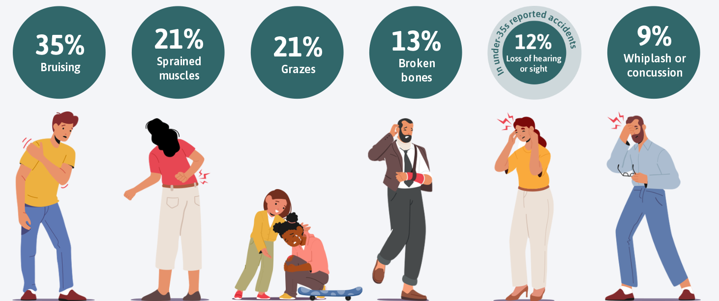
Everyday accidents in the UK
Common outcomes of accidents: The physical impact

Slide 6
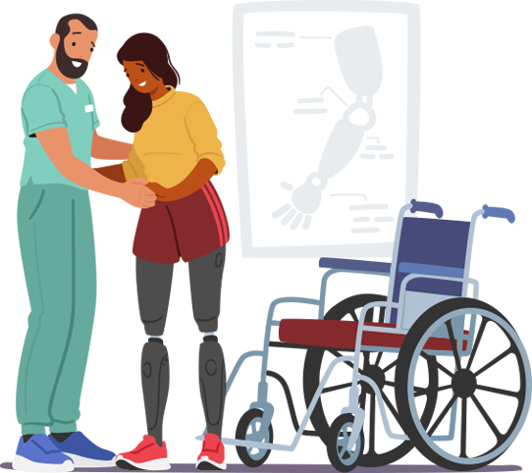
Accidents have lasting effects
Long term consequences
20% had to change their daily routines.
15% now live with long-term disabilities or conditions (rising to 23% among under-35s).

Slide 7
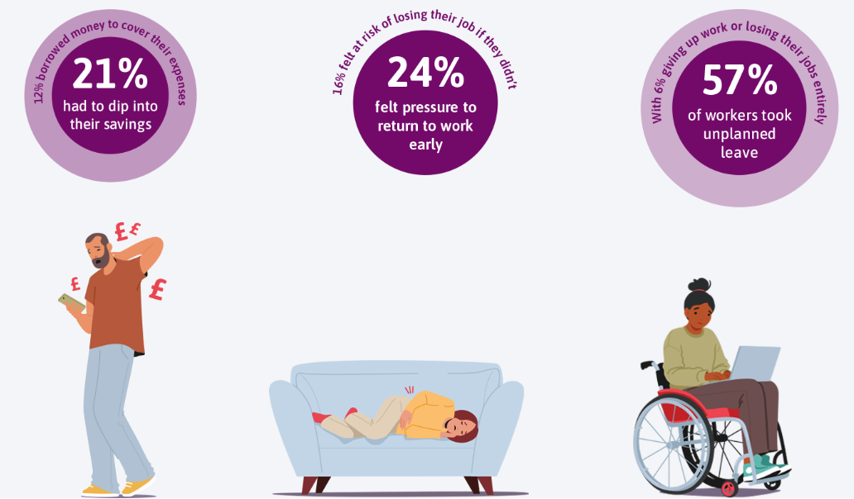
The hidden costs of accidents
Financial strain in the aftermath

Slide 8
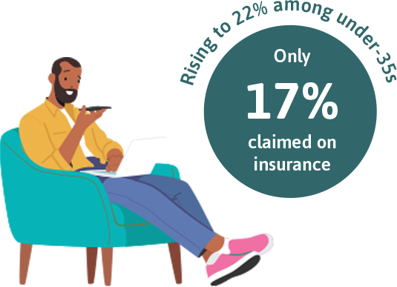
Why Protection matters
Bridging the gap with Protection
Only 17% of people claimed on insurance products like Income Protection.
Highlights the critical role of financial support in recovery.

Slide 9
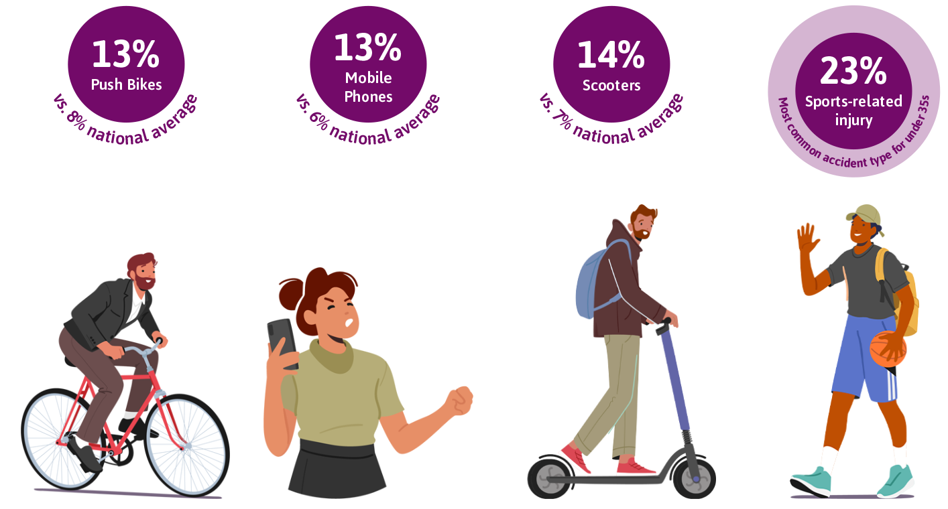
Accident risk among under-35s
Over a third (37%) of under-35s experienced an accident in the past three years—higher than the national average.
Common accident causes:

Slide 10
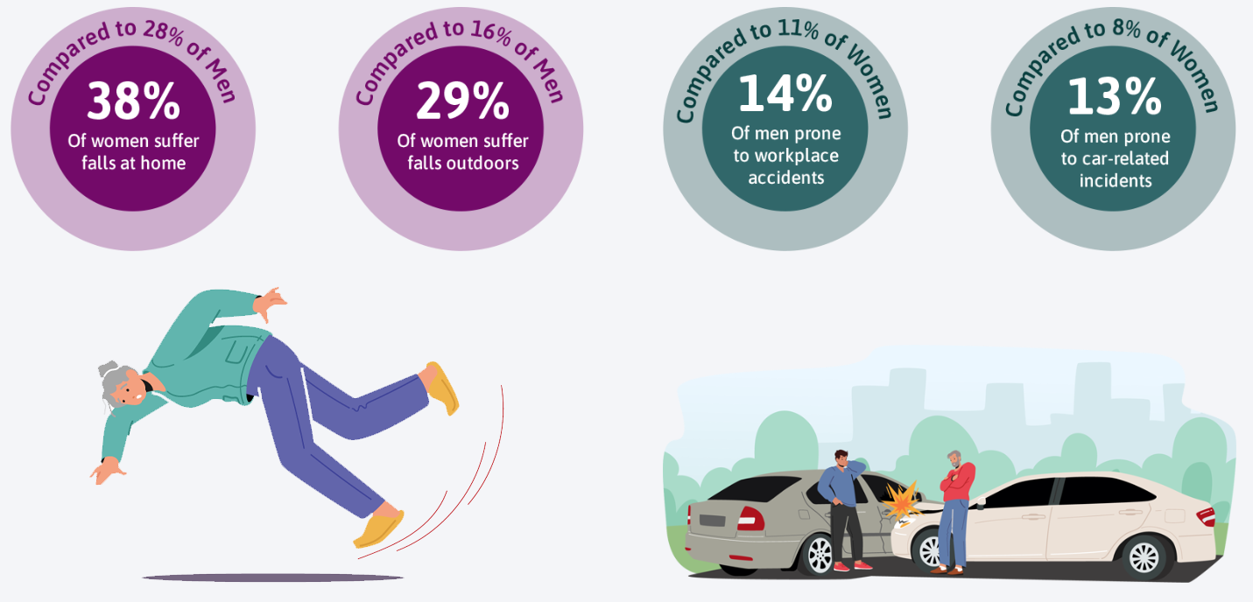
Gender differences in accident trends
Women are more likely to suffer falls at home and outdoors, while men are more prone to workplace accidents and car-related incidents.

Slide 11
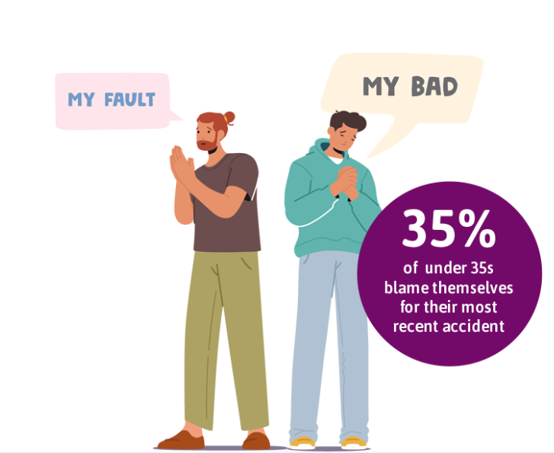
Where and why accidents happen
The most common accident locations include public roads (13%), living rooms (9%), outdoor public places (8%), kitchens (8%), and stairs (7%).
Interestingly, 43% of Britons blame themselves for their most recent accident, but this number drops to 35% among under-35s.

Slide 12
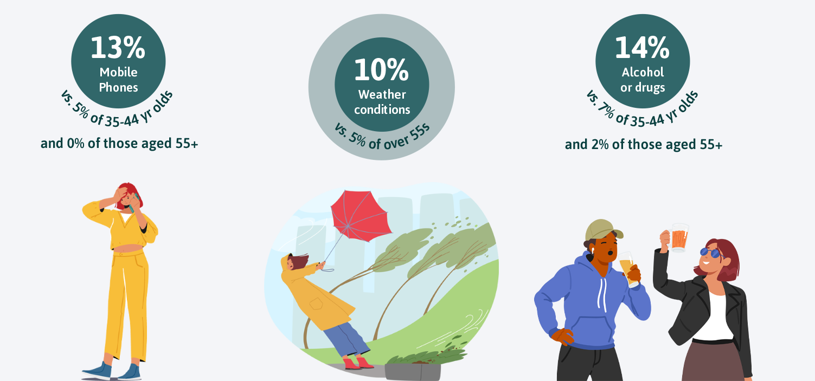
Risk factors for younger people

Slide 13
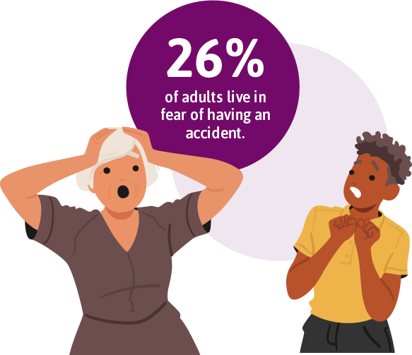
Brits fear costly consequences of accidents as financial and NHS concerns mount
One in four (26%) adults live in fear of having an accident, a figure that rises to 31% among women and 34% among young people (aged 18-34).
In fact, when it comes to their personal safety and the likelihood of having an accident day to day, over half (51%) consider themselves to be ‘risk-averse’.
Brits who think they will have an accident expect to have an average of eight accidents in a lifetime, but 14% think they may have nine or more. Optimistically 13% of British adults don’t think they will ever have an accident during their whole lifetime.

Slide 14
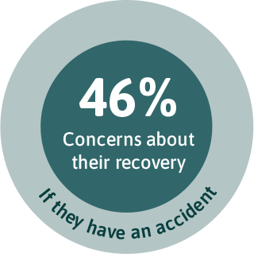
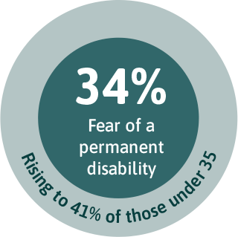
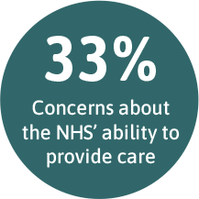
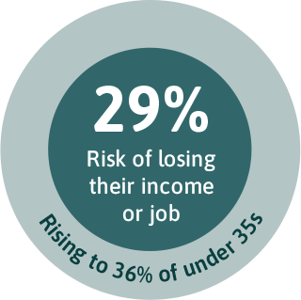
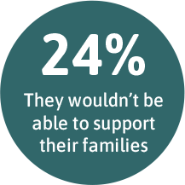



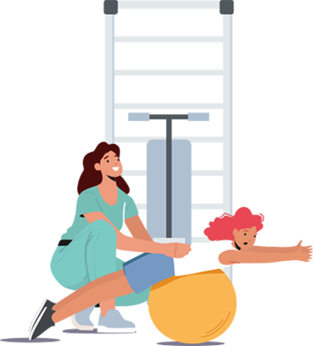

Fears of permanent disability and financial impacts of an accident
Among those who are fearful of having an accident, their reasons include:

Slide 15
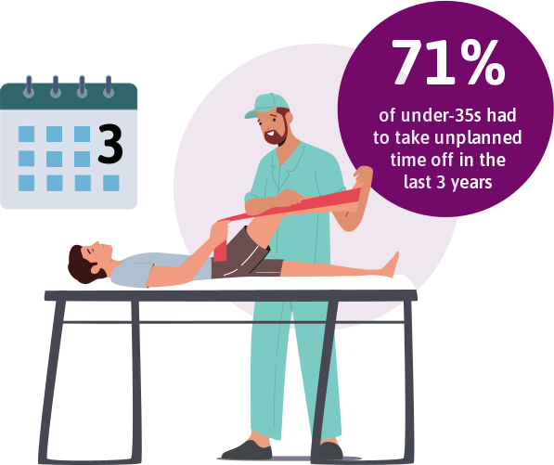
Unplanned leave

Slide 16
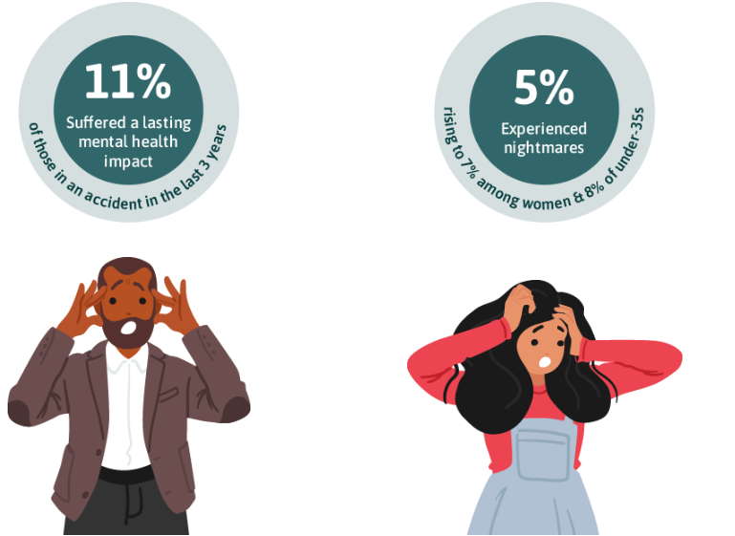
The mental health toll of everyday accidents
Accidents don’t just leave physical scars - they can take a serious toll on mental wellbeing too.
One in ten (11%) of those who’ve had an accident in the past three years suffered a lasting mental health impact.

Slide 17

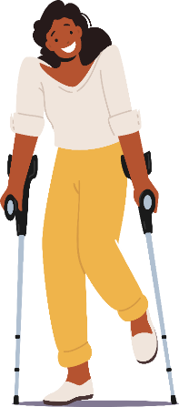
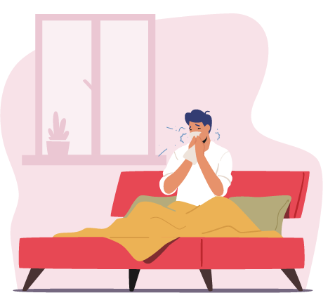
Our Protection family
Friendly Shield
Accident Only IP
Income Protection
A short-term protection policy to cover the consequences of everyday accidents and sickness.
Affordable from £10 per month
Quick to open and apply for
Cover for the whole family
Simple 3 cover levels
No medical underwriting
Optional sickness cover
An alternative for clients who’ve been declined for full IP, can’t afford it or have heavy loadings based on health grounds.
No underwriting (Ideal for younger workers who just want accident cover)
Optional cover for hazardous pursuits and accidental death
70% of income limit, higher than industry average
A sensible approach to underwriting, getting your clients terms which are clear and fair.
70% of income covered, higher than industry average
Immediate cover for well controlled type 2 diabetics
Add cover for hazardous pursuits and accidental death
Market-leading benefit guarantee of £3,000 a month.

Slide 18
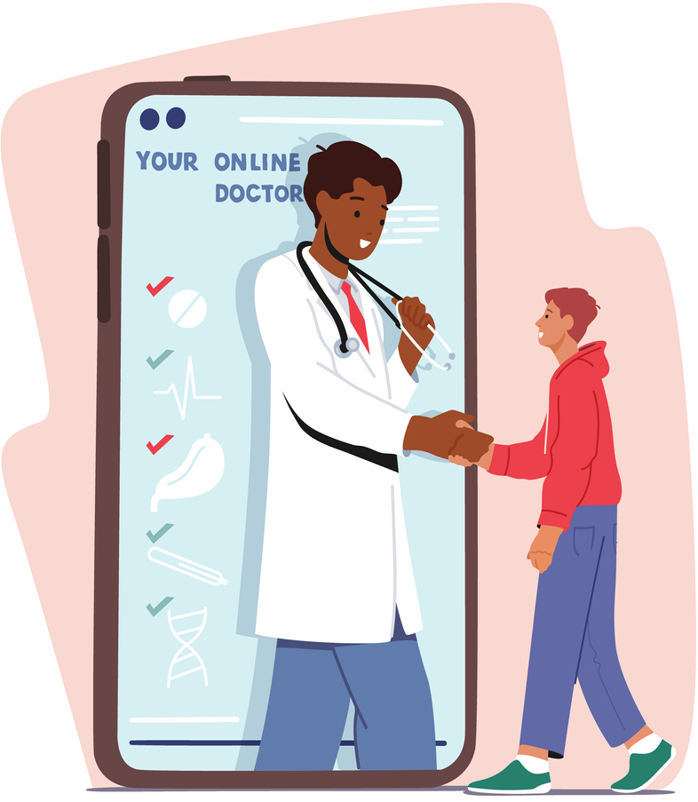
Value beyond financial support:
Free access to Friendly GP+ (16+)
Our virtual GP service is a free added benefit on these plans.
It can be accessed over the phone or online 24 hours a day, 7 days a week so your clients can always speak to a doctor when they need one.
Not only is it there to support your clients, but their children and partners too.
Features:
24/7 unlimited GP telephone consultations
Video consultations
Private prescriptions
Open referrals
Physiotherapy
Counselling
Health and wellbeing guidance and hub
Money and debt help

Slide 19
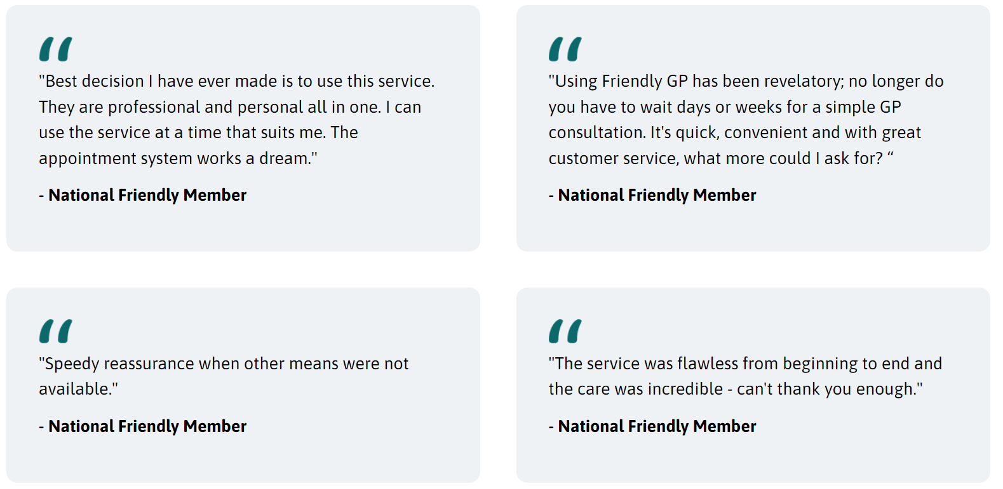
Value beyond financial support:
What our members say about Friendly GP+

Slide 20

Supporting your client conversations
Bridging the gap with Protection
Use key stats to highlight the importance of income protection, especially to younger lives, whose concerns seem more acute.
Share the Bruised Britain landing page with clients for added credibility.
Build trust with data-driven advice.
National Friendly is a credible provider who understands client needs with products designed to fulfil their requirements.
Bruised Britain Research here

Slide 21
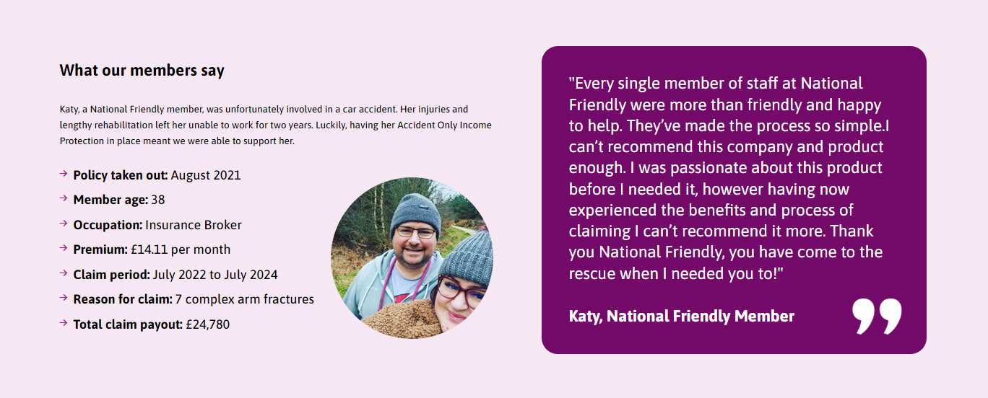
Cover that meets consumer needs

Slide 22
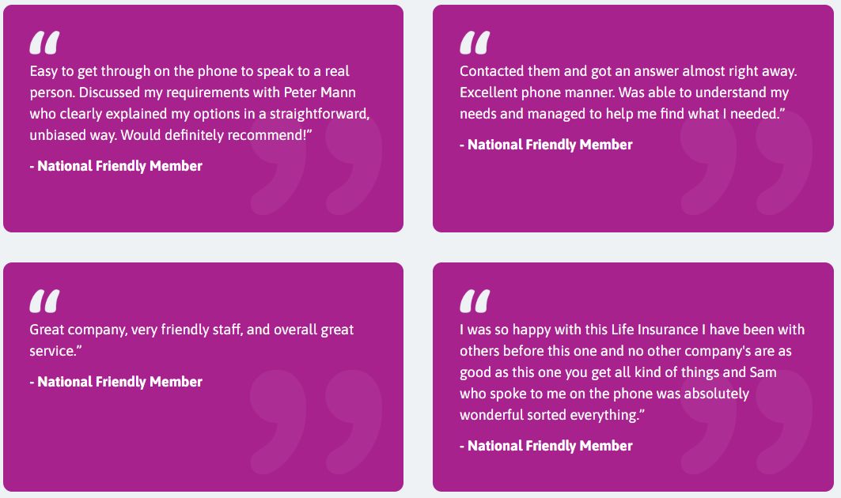
About Us
A friendly society that’s been around for 157 years supporting our members through all of life’s stages.
We’re owned by our members, not shareholders, so we always work with members’ best interests in mind. Our profits are used to enhance the service we provide.
Our members rate us 4.6 out of 5-stars (Medallia, Dec 2024)
Notes:
Run through

Slide 23







We’ve been shortlisted for many awards through the years:
  Underwriting and Claims, Highly Commended, Protection Review 2024 (and 2023)
  Outstanding Individual Income Protection, Finalist, Cover Excellence Awards 2024
  Outstanding Intermediary Support Team, Finalist, Cover Customer Care Awards 2024
  Outstanding Underwriting Team, Finalist, Cover Customer Care Awards 2024
  Customer Service: ‘Above and Beyond’, Finalist, Cover Customer Care Awards 2024
  Best New Product, Highly Commended, Protection Review 2024
Notes:
Run through

Slide 24



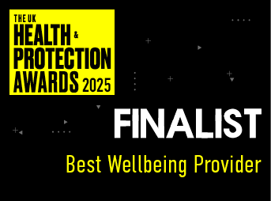

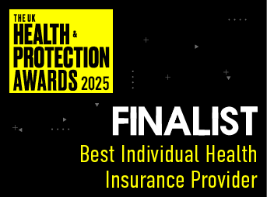

Our achievements
In 2025, we were shortlisted for and won the following awards:
LifeSearch Awards 2025
  Best Income Protection Provider (Shortlisted)
  Extending Accessibility and Inclusivity (Shortlisted)
Cover Magazine – Customer Care Awards 2025
  Outstanding Underwriting Team (Finalist)
  Customer Service: ‘Above and Beyond’ (Finalist)
Health & Protection Awards 2025
  Best Diversity & Inclusion Strategy (Shortlisted)
  Best Wellbeing Provider (Shortlisted)
  Best Add-on or Support Service (Insurer) (Shortlisted)
  Best Individual Protection Provider (Shortlisted)
  Best Individual Health Insurance Provider (Shortlisted)
Notes:
Run through

Slide 25
Thanks for listening.
Any questions?
The research was conducted by Opinium Research between 1-5 November 2024 among 2,000 UK adults.
National Friendly is a trading name of National Deposit Friendly Society Limited. Registered office: 11-12 Queen Square, Bristol BS1 4NT. Registered in England and Wales no. 369F. National Deposit Friendly Society Limited is authorised by the Prudential Regulation Authority and regulated by the Financial Conduct Authority and the Prudential Regulation Authority. Our Financial Services Register number is 110008. You can check this at: https://register.fca.org.uk. National Deposit Friendly Society Limited is covered by the Financial Services Compensation Scheme and Financial Ombudsman Service.
BB Research 05.25

